Slide 1
DE Assignment#1-Q#2
PREPARED BY: IBRAHIM SHAHBAZ

Slide 2
Setting up the Environment
Follow the instructions in the ReadMe file to perform the following:
Create mounted folders ( mkdir ./dags ./logs ./plugins ./data)
Place the CSV file (covid19.csv) into the mounted folder “data”.
Place the CSV_to_JSON DAG file in the mounted folder “dags”.
echo -e "AIRFLOW_UID=$(id -u)\nAIRFLOW_GID=0" > .env
initiate Airflow by: docker-compose up airflow-init
Run the application by: docker-compose up

Slide 3
Important Network Ports
Service | Port Number
Airflow web server | 8080
PgAdmin | 8000
MongoExpress | 8081

Slide 4

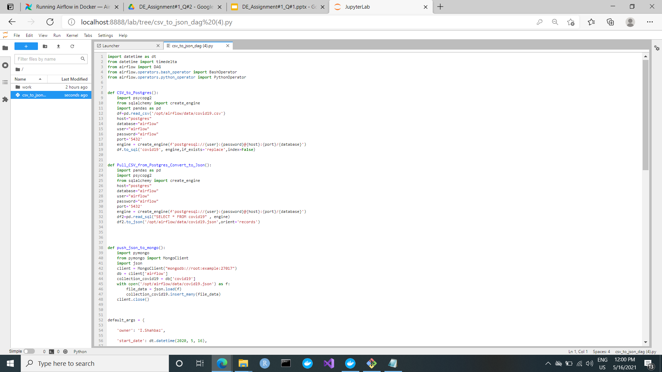
DAG file

Slide 5
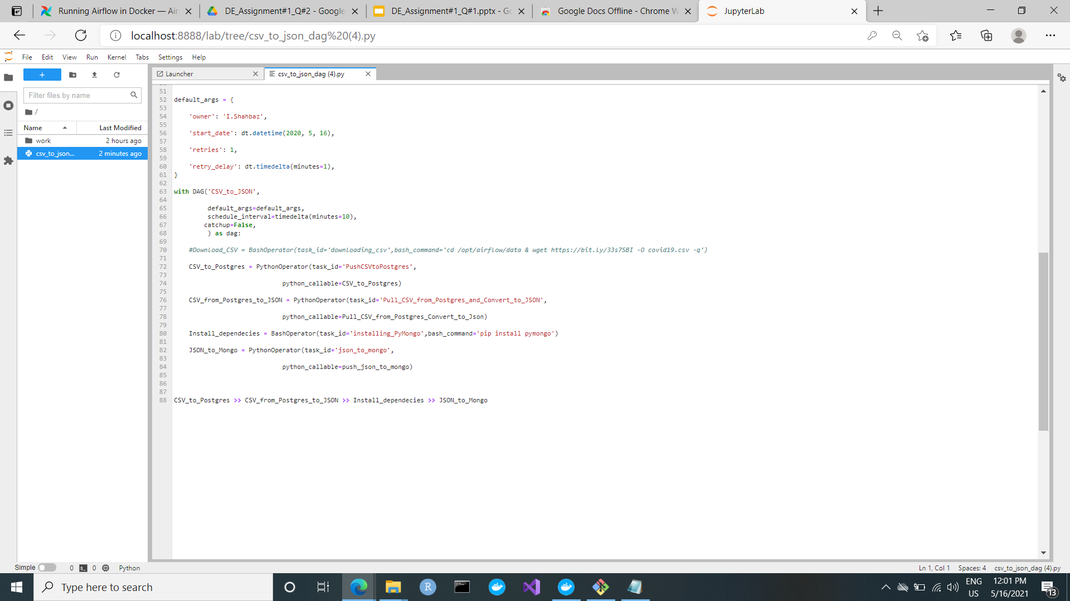
DAG file

Slide 6
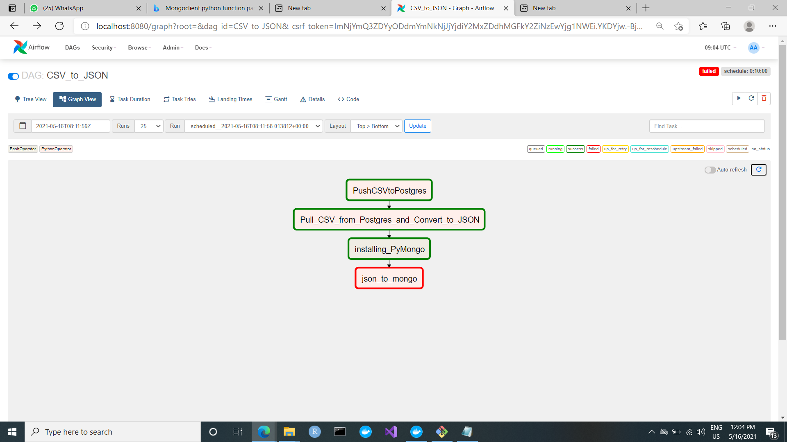
Proposed Workflow on Airflow

Slide 7
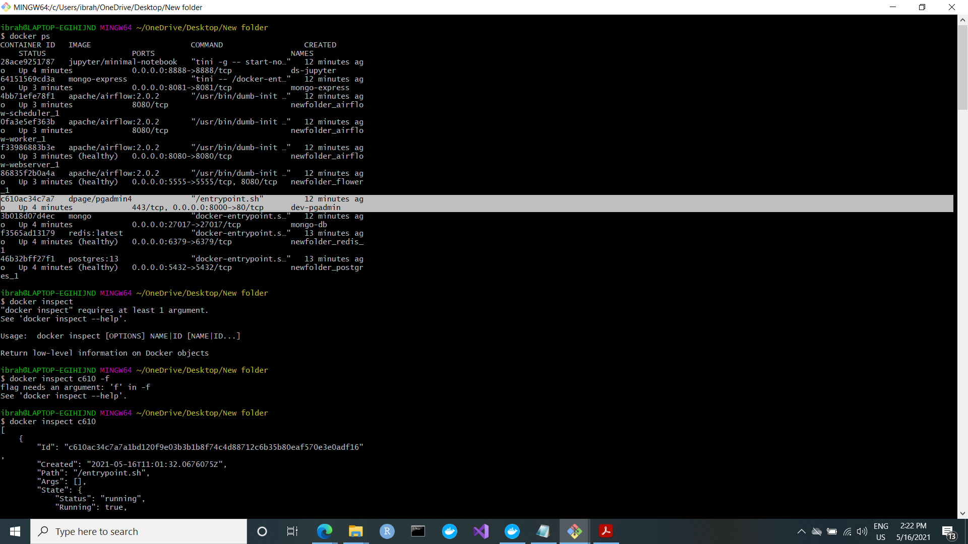
PgAdmin
docker ps ##get container id for postgres
docker inspect {container id}

Slide 8
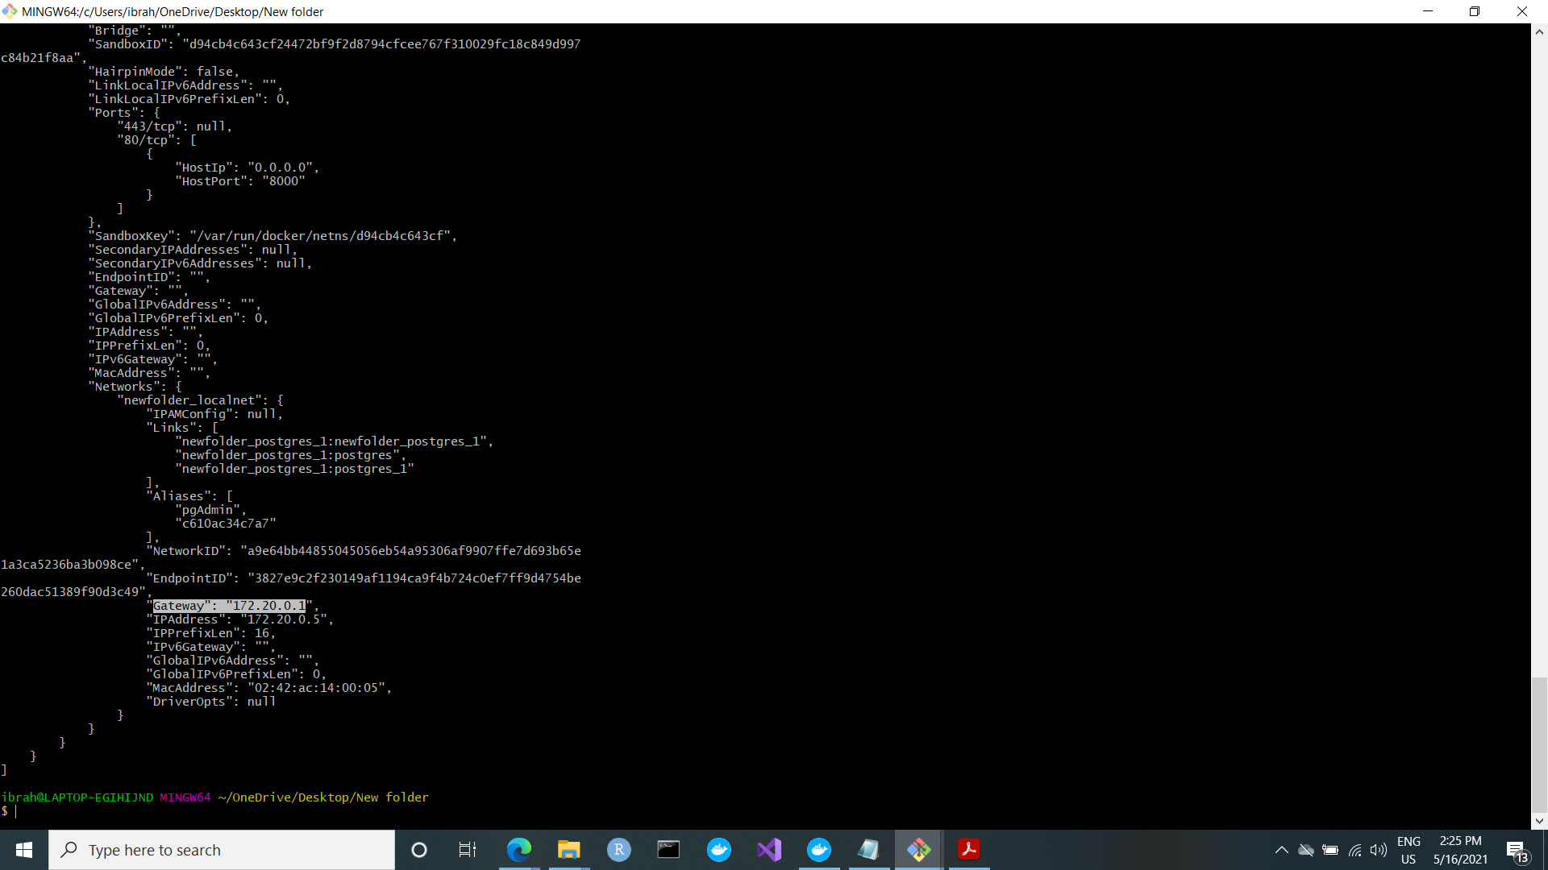
PgAdmin

Slide 9
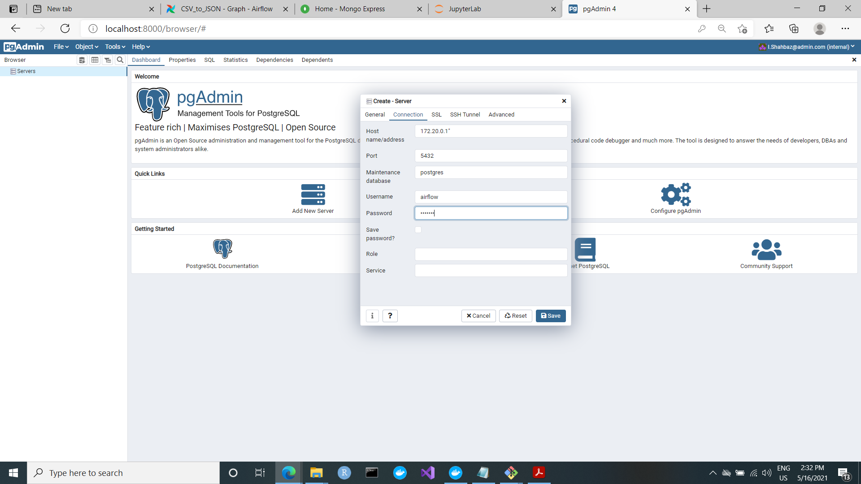
PgAdmin

Slide 10
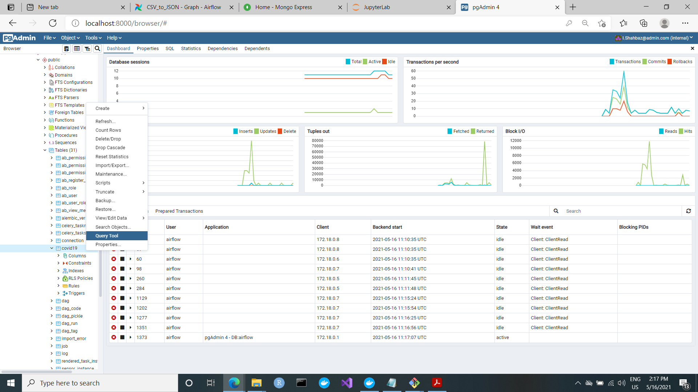
PgAdmin

Slide 11
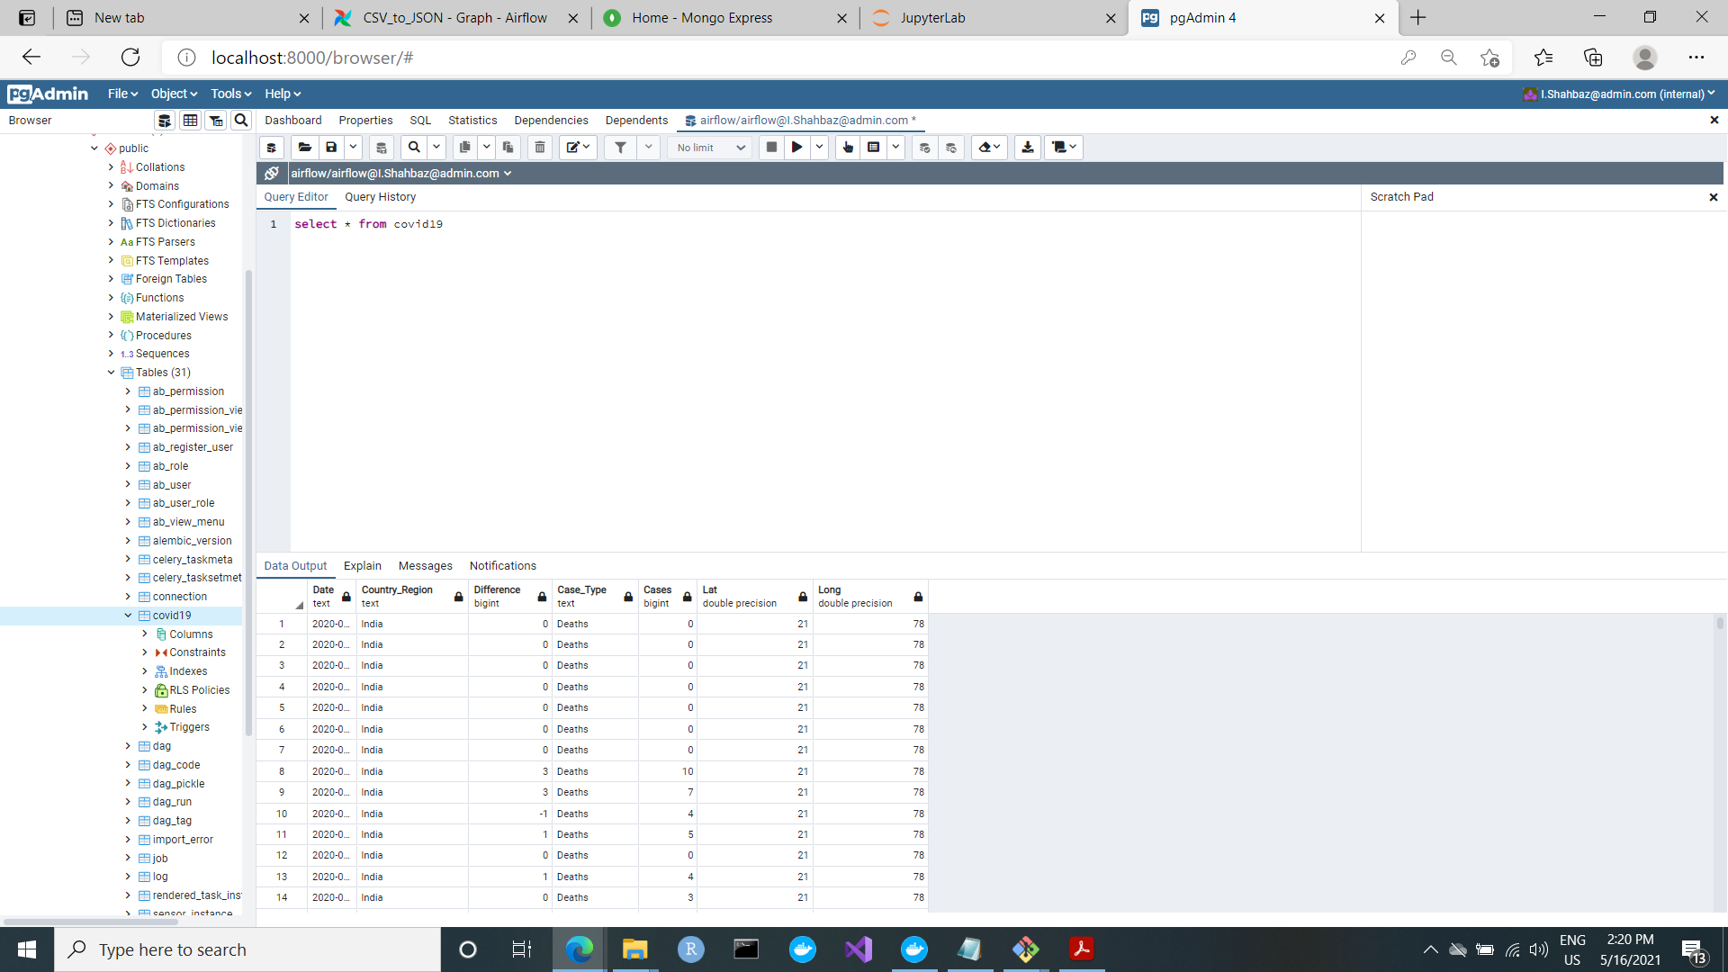
PgAdmin

Slide 12
Proposed Workflow on Airflow

Slide 13
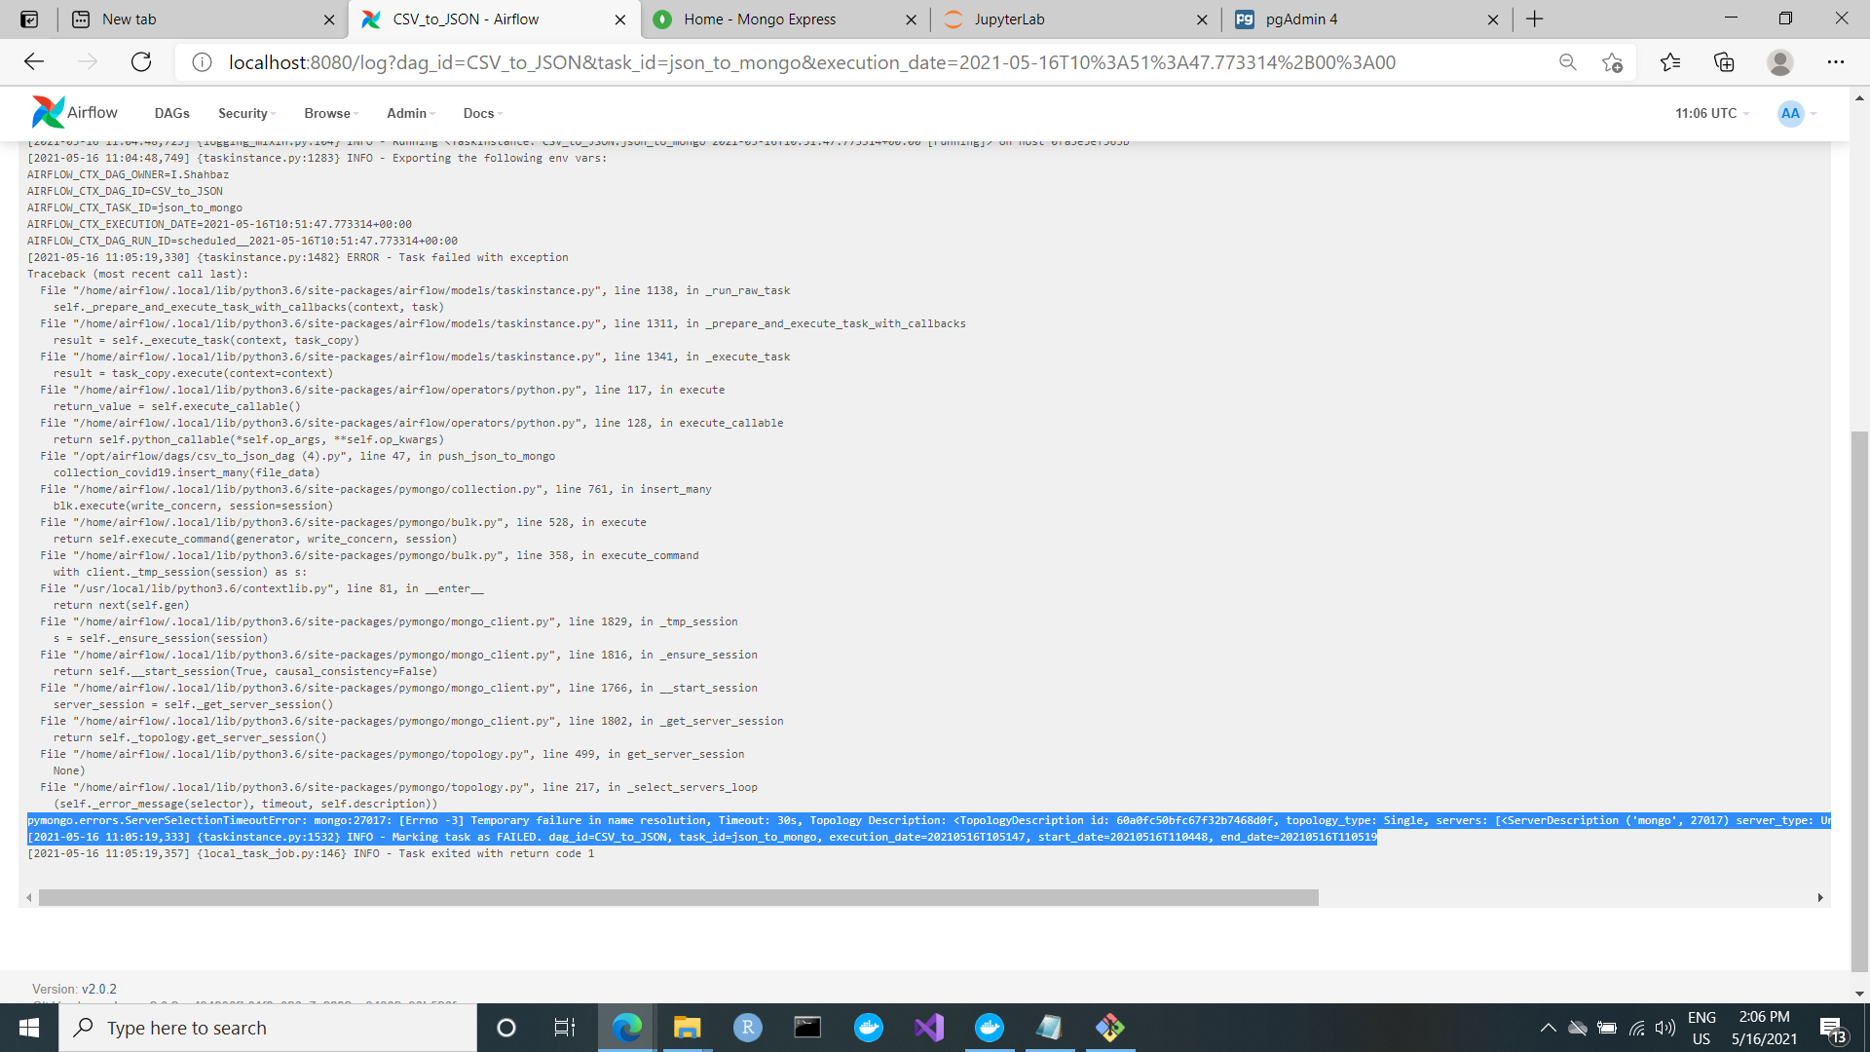
Network Connection Error on last stage of the DAG “JSON_to_Mongo”

